Slide 1
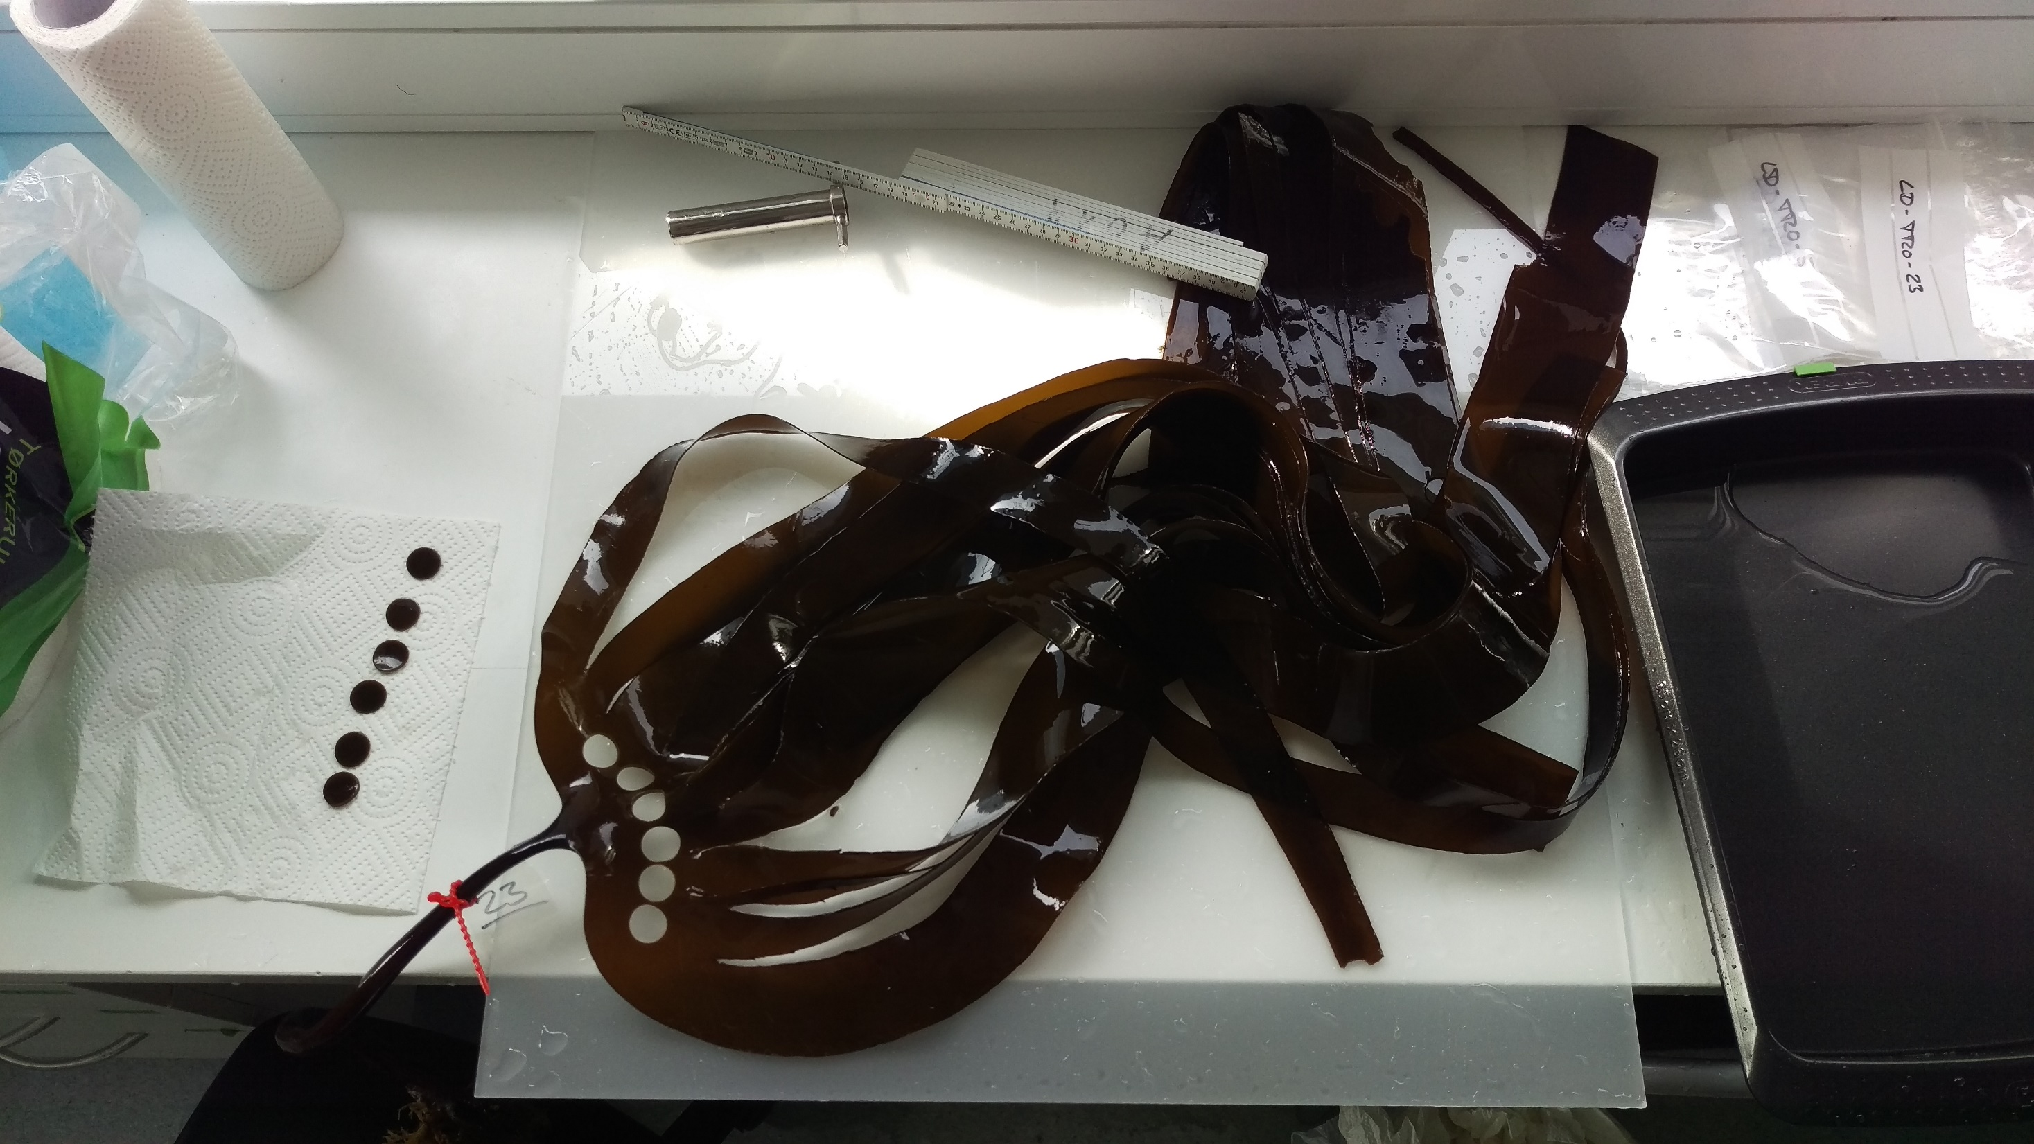
Notes:
Photo Daniel Liesner: preparation of samples for heat resilience experiments on Laminaria digitata

Slide 2
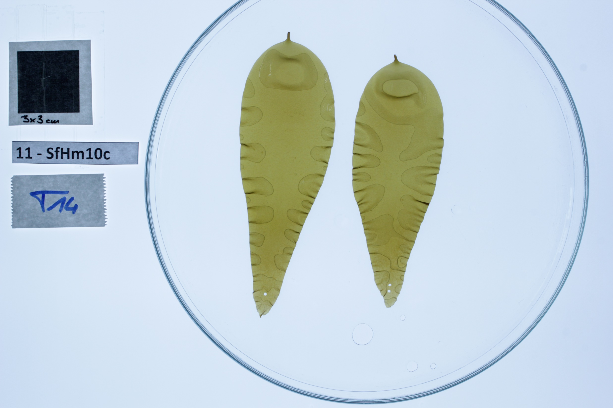
Notes:
Photo: daniel Liesner. Determination of growth rate of juvenile kelps via photographic recording for plasticity analysis experiments

Slide 3
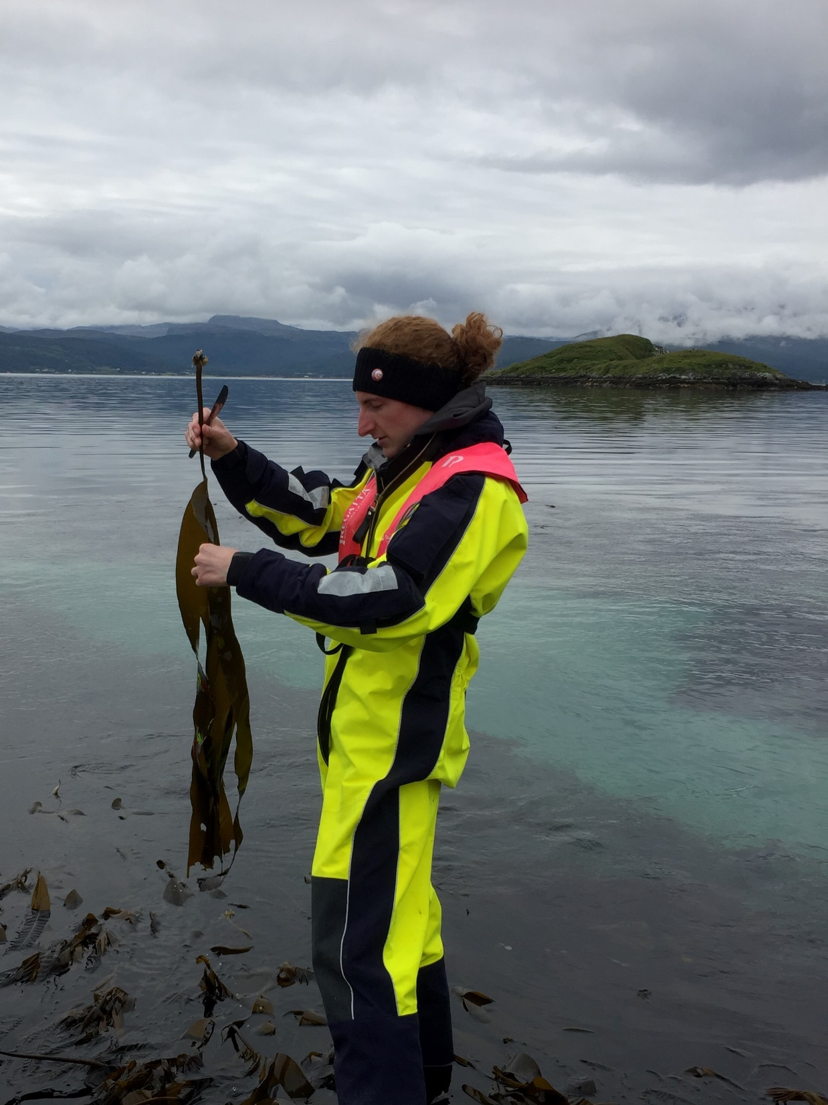
Notes:
Photo: ???. Daniel Liesner collecting Laminaria digitata near Tromsö (Norway) during summer 2018 for heat resilience experiments

Slide 4
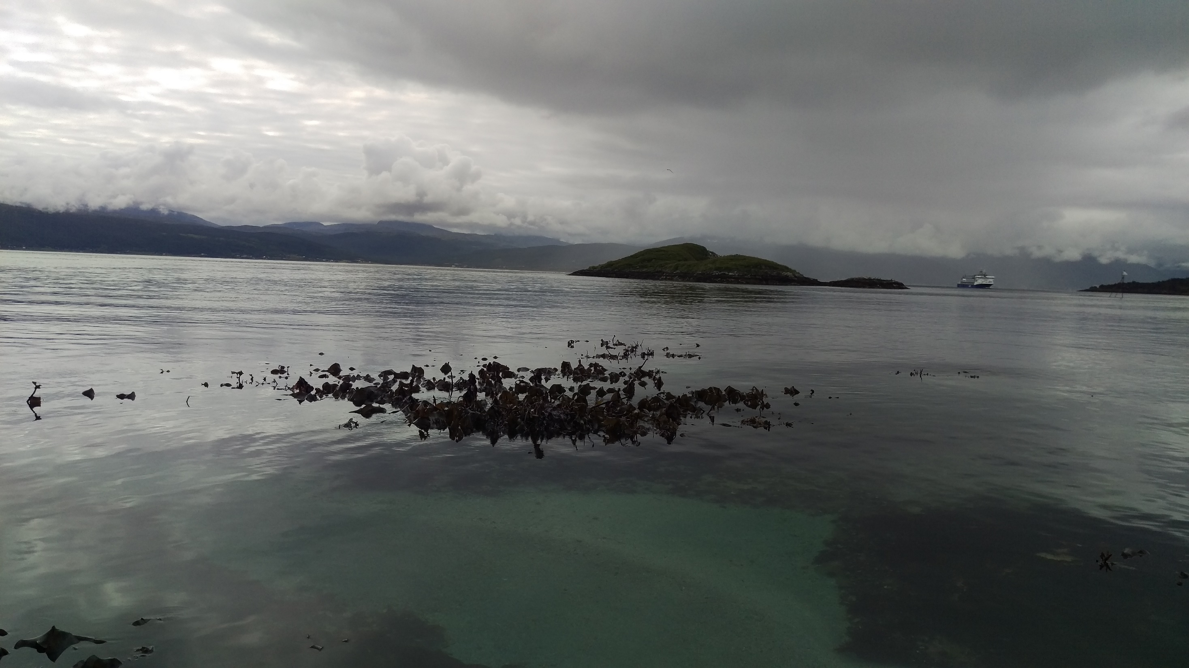
Notes:
Photo: Daniel Liesner. Luckily we were spotting healthy Laminara digitata fields near to Tromsö that had not been grazed by sea urchins

Slide 5
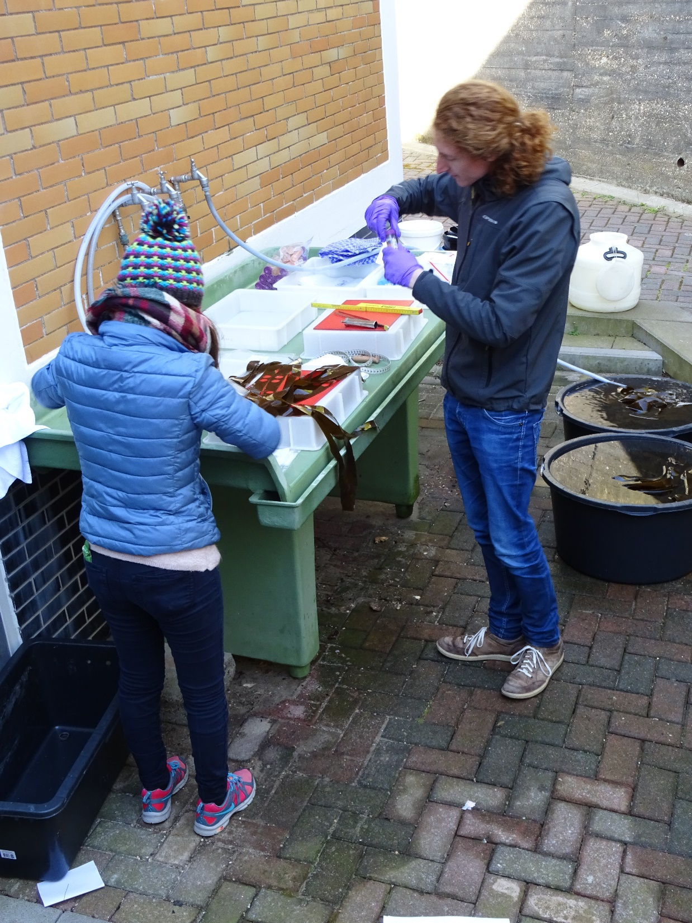
Notes:
Foto: Inka Bartsch: Daniel Liesner (AWI) and Neusa Martins (CCMAR) cooperating in spring 2017 during collection of Laminaria digitata at Helgoland (North Sea)

Slide 6
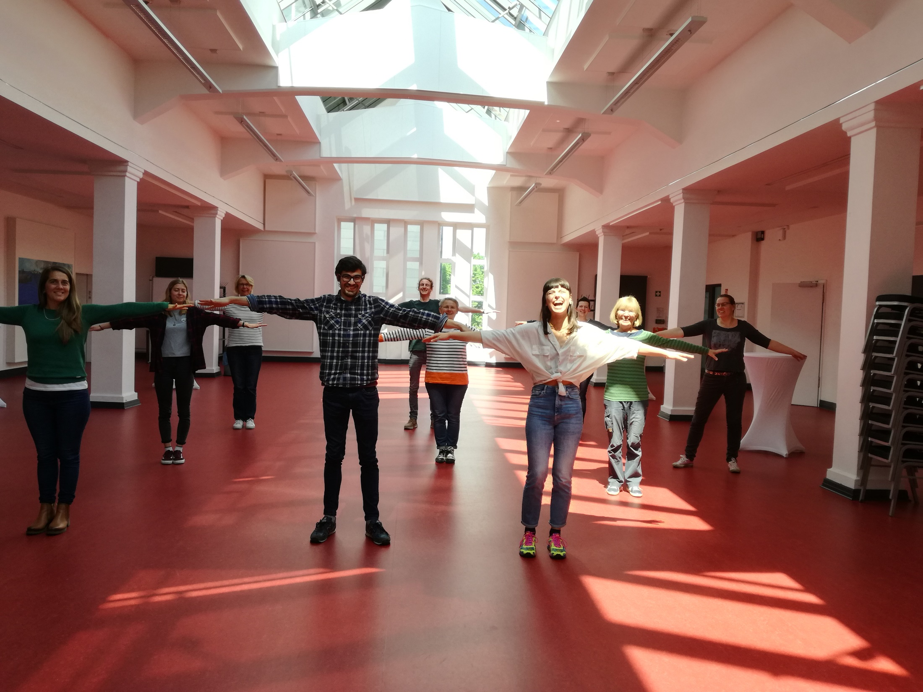
Notes:
Foto: Inka Bartsch. Work group at AWI in times of Corona. Spring 2021. Good bye session for master students Laura Pageault and Clément Gauci from AMU having worked in the context of the MARFOR project

Slide 7
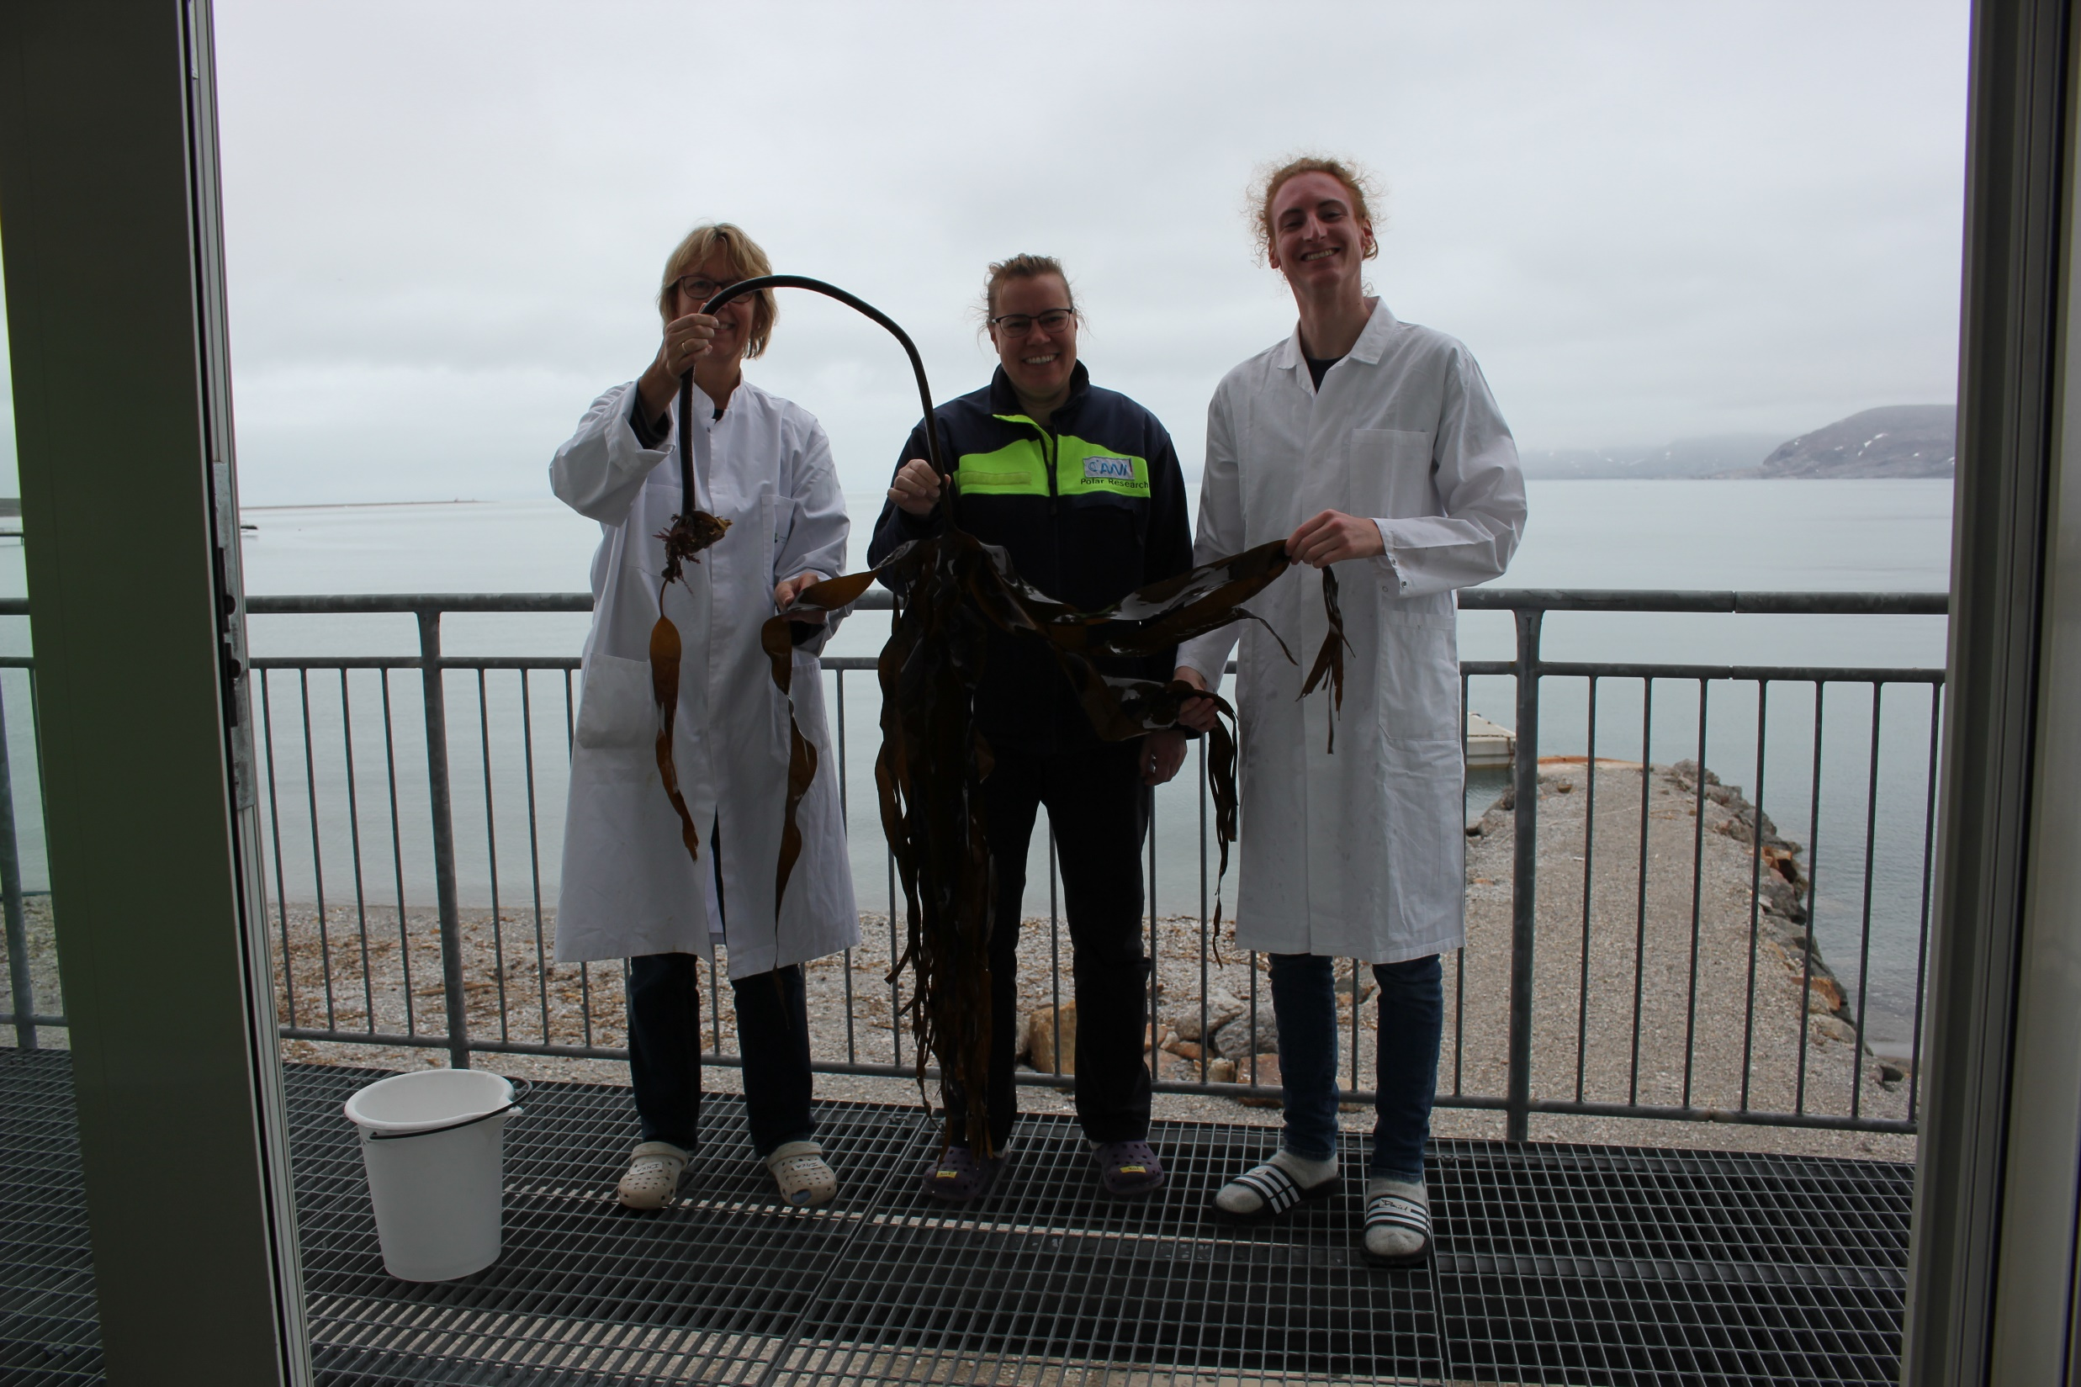
Notes:
Foto: Inka Bartsch. Inka Bartsch, Katharina Zacher and Daniel Liesner in summer 2019 at the Marine Laboratory taking samples of Laminaria digitata for the heat resilience experiment along latidudinal gradients

Slide 8
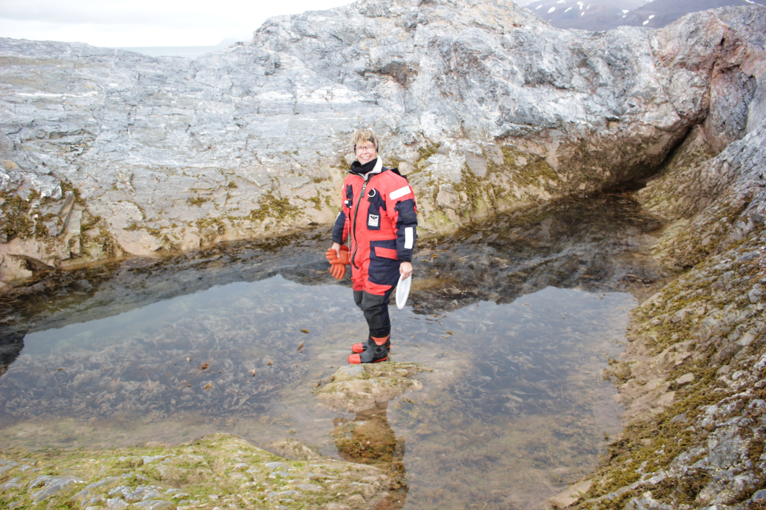
Notes:
Foto: Daniel Liesner. Inka Bartsch collecting seaweeds in the context of MARFOR in Kongsfjorden, Spitsbergen in summer 2019

Slide 9
Notes:
Foto: Inka Bartsch. Working with kelps is not always a clean business. After anaylsing in situ samples for demographic data on Laminaria digitata in the frame of MARFOR in summer 2019 in Ny Alesund, Spitsbergen

Slide 10
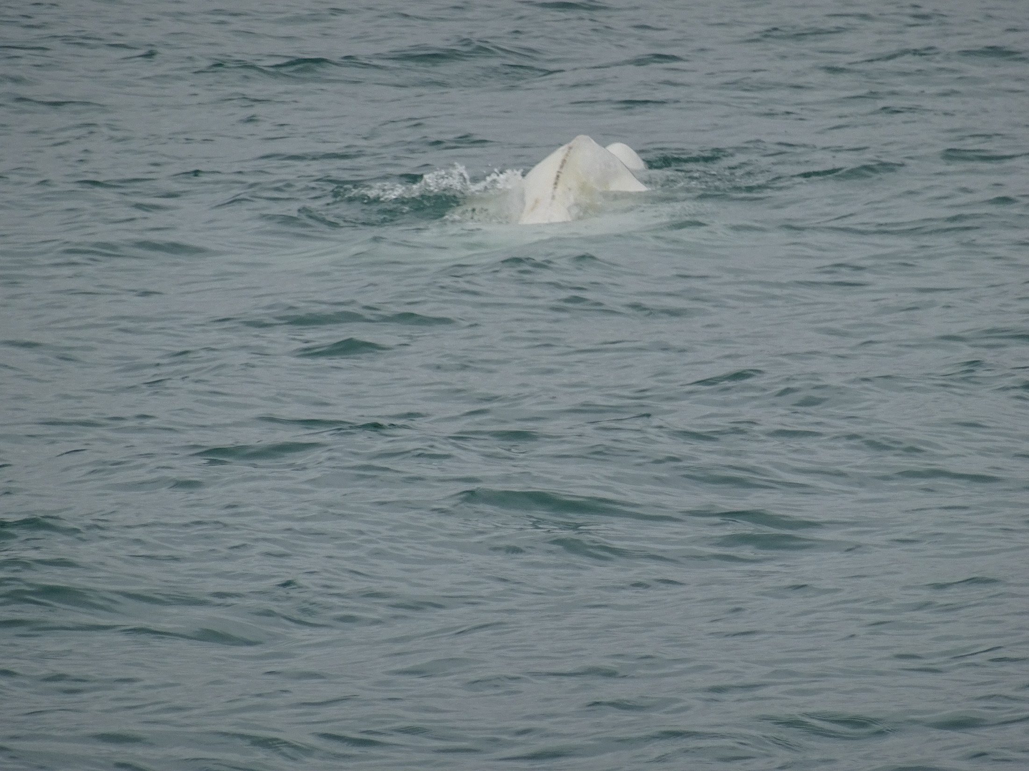
Notes:
Foto Inka Bartsch: not only macroalgal are exciting. Sighting of a Beluga whale in Kongsfjorden during 2019 summer campaign for MARFOR

Slide 11
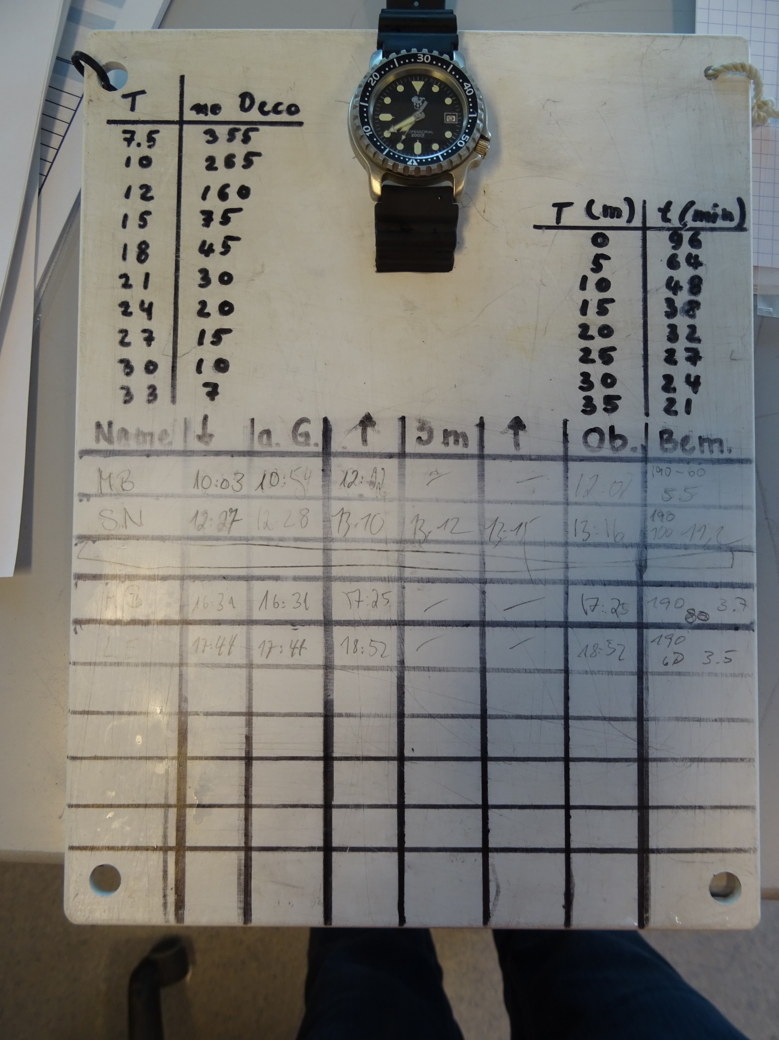
Notes:
Foto: Inka Bartsch. Handover of in situ data taken by divers to assess the demography of Laminaria digitata in Kongsfjorden in the frame of MARFOR

Slide 12
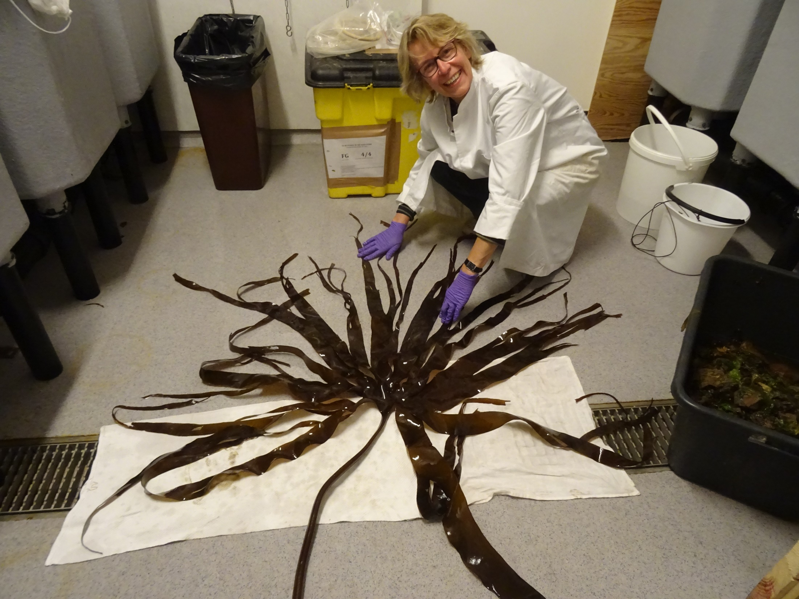
Notes:
Foto: Daniel Liesner. Hairdressing of Laminaria digitata for taking photos in order to assess the leaf area of blades per m² as a proxy for kelp productivity. Summer 2019, Spitsbergen.

Slide 13
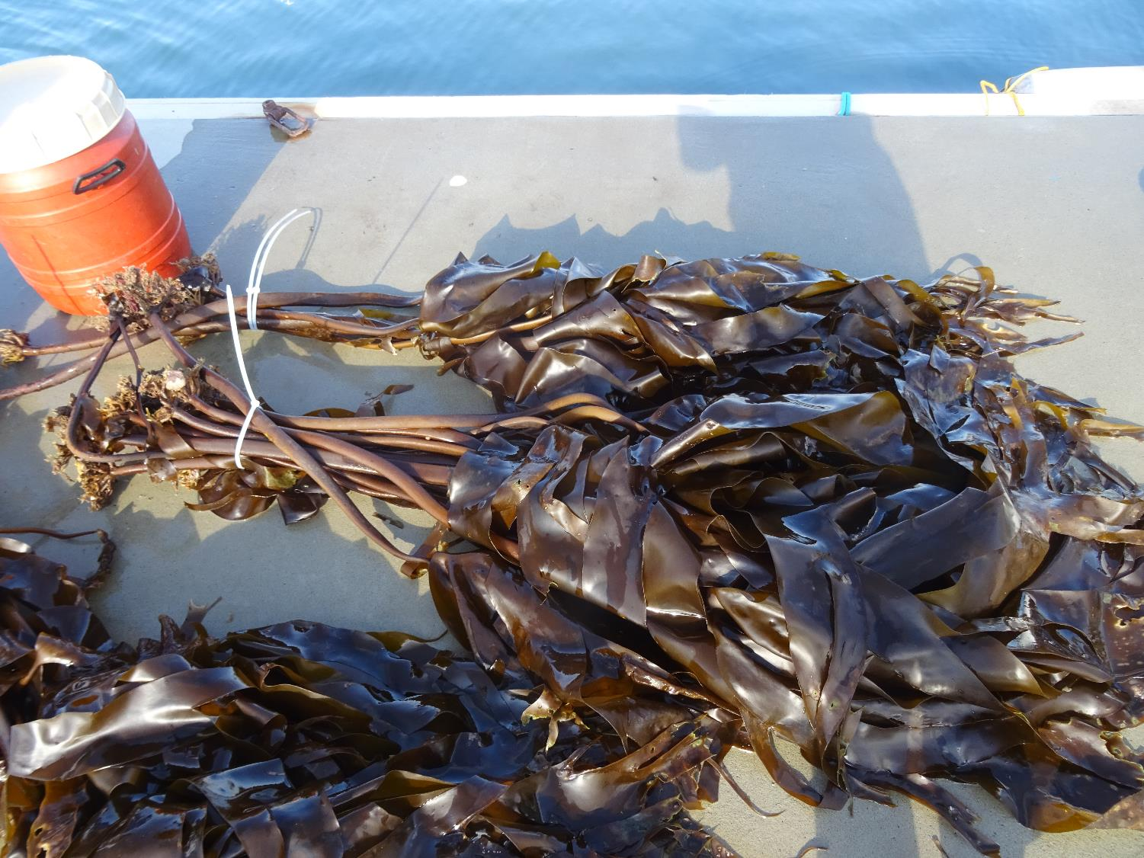
Notes:
Foto: Inka Bartsch. Mixture of kelps Laminaria digitata and Hedophyllum nigripes for further analysis of demographic data in the frame of MARFOR. Each bundle represents the biomass for 1 m². Summer 2019. Kongsfjorden, Spitsbergen

